Slide 1
Analytics Overview
Dr. Satish Nargundkar
Georgia State University

Slide 2
Types of Analytics
Descriptive [Visualizing what is]
Centrality/Variation
Charts/Graphs/Tabulations
Segmentation - Cluster Analysis
Predictive [What is likely to happen]
Regression Techniques – Linear, Logistic
Times Series: Trend, Seasonality
Association: Market Basket Analysis, Recommendation Systems
Prescriptive [What do we do about it?]
Optimization: Linear Programming
Decision Analysis: Bayes’ Theorem
Simulation

Slide 3
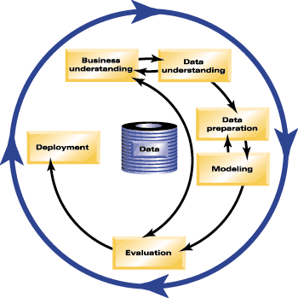
The Data Mining Process
Monitoring
Communication
Shearer, 2000
The Cross-Industry Standard Process for Data Mining (CRISP-DM)

Slide 4
Application in Financial Services
Product
Planning
Customer
Acquisition
Stage 1
Stage 2
Customer
Valuation
Collections
and
Recovery
Customer Manage-ment
Stage 4
Stage 3

Slide 5
Measuring Effectiveness
Lift/Gains Chart
100
Targeting
90
Percent of potential
responders captured
Random mailing
45
0
45
100
Percent of population targeted

