Slide 1
Analytics Overview
Dr. Satish Nargundkar
Georgia State University

Slide 2
Analytics Tasks
Framing the problem
Data Collection, Data Preparation
Description, Visualization
Model Development
Segmentation
Prediction
Association
Optimization
Simulation
Model Evaluation
Communication
Monitoring

Slide 3
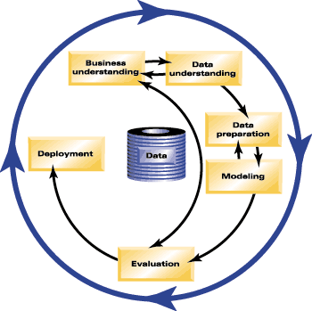
The Data Mining Process
Shearer, 2000
The Cross-Industry Standard Process for Data Mining (CRISP-DM)

Slide 4
Application in Financial Services
Product
Planning
Customer
Acquisition
Stage 1
Stage 2
Customer
Valuation
Collections
and
Recovery
Customer Manage-ment
Stage 4
Stage 3

