Slide 1
Databases
Aruna Manyam
Database Architect – Delta Airlines

Slide 2
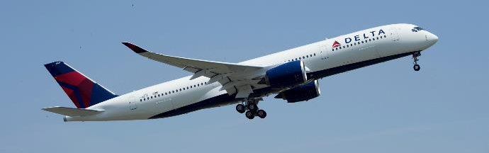
Delta Airlines
The Largest Airline in the world in Market Capitalization - $39.4B.
The Second largest airline in the world in revenue - $40B.
The Second largest airline in passengers carried - 500,000/day.
The Second largest in fleet size – 850+ aircraft.
Operates Over 5,400 flights daily.
Over 80,000 employees.

Slide 3
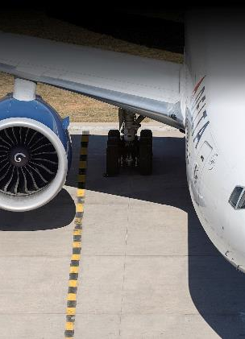
Information Technology in Delta
From passenger ticketing to aircraft maintenance, its importance cannot be emphasized enough.
Flight Operations
Technical operations
Airport Customer Service
Revenue Management
Network (Flight Schedules)
Finance
Planning
In-flight Service
Fuel Management
Supply Chain
Reservation and Customer care

Slide 4
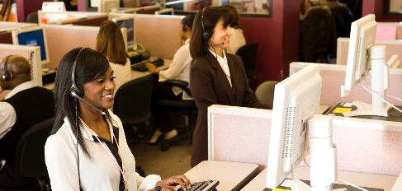
My role in Delta Airlines
Gather the Data storage, Access, Availability , Business requirements and Design Database Technology and Processes.

Slide 5
Information is vital!
When we think of airlines, we think of reservations, boarding passes, baggage tags and other passenger facing information, but information plays a vital role in every aspect of Delta’s operations.
Customer Facing
Reservations
Ticketing & Boarding Passes
Skymiles
Baggage handling
Itinerary changes
Seating
Flight schedules
Non Customer Facing
Aircraft Maintenance
Weather Issues
Pricing
Load Management
Food
Payroll
Employee benefits
Crew scheduling
And where large volumes of data exist, there we need efficient databases to manage them

Slide 6
Databases can be categorized by Function or how the data are Structured.
Databases
Function
Operational
Reporting and Analytics
Structure
Relational Databases
EXAMPLES:
Ticketing, boarding pass, luggage tags, flight schedules.
EXAMPLES:
Pricing Analysis, schedule analysis, weather analysis
Data Warehouse / Big Data
EXAMPLES:
Oracle, SQL Server
EXAMPLES:
Oracle, TerraData

Slide 7
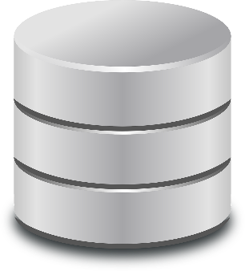
Operational Databases – RDBMS
Used mainly for Online Transaction Processing (OLTP) because of
Rapid Response Time
Eliminate Data Redundancy
Ensure Data Integrity.
Note: Response times of .033 secs
6000 Transactions per sec.

Slide 8
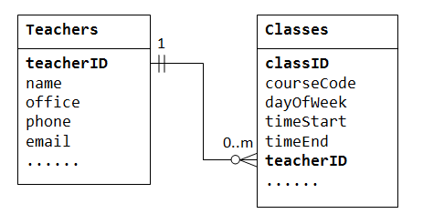
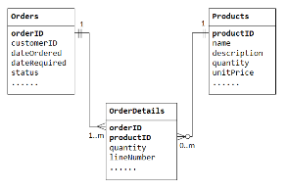
RDBMS: A structured database
RDBMS delivers the benefits elaborated in the earlier slide because it has highly structured data.
Organizes Data in tables. A table has rows and columns
Tables have one to many and many to many relationships to maintain data integrity.

Slide 9
Data Types : How do we store different kinds of data Using SQL
Integers/numbers
Characters
Large texts
Objects - Large Objects
Images - Videos/Pictures/graphs
Social Media Data as XML

Slide 10
Examples of using DataTypes
Create table teachers (
  teacherID number NOT NULL,
  name varchar2(300) NOT NULL ,
  Office varchar2(100) NOT NULL,
  Date of Join Date,
  Phone number ,
  email varchar2( 20) )
Insert into table teachers
  values ( 1, ' Thomas Hardy' ,'School of Business' , 12-AUG-2013', 2013341234,'th@gmail.com');
Video file and Large Images are usually stored on the disk and have the Metadata pointers in the database
CREATE TABLE GAME (
  GAME_ID INTEGER NOT NULL PRIMARY KEY,
  GAME_NAME VARCHAR (20),
  VIDEO LONGBLOB );
INSERT INTO GAME
  values (3, 'Termonator2',LOAD_FILE("C:\\Users\\Public\\Videos\\Sample Video\\test.mpg"));

Slide 11
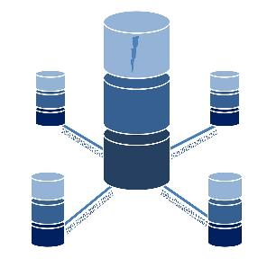
Retrieve Data
Various Applications are used to retrieve data.
- Web based Apps
- Java
- API ( Application Programming Interface)
- Apps on Devices

Slide 12

Size of the databases
Size of databases depends on the data retention/Data Lifecycle Management polices .
In Delta,
  Operational Databases are relatively small (800gb – 30 TB) with Data retention of 1-2 years.
  Data warehouse Databases are large (100s of TBs) and Data retention is longer (7-10 Years).

Slide 13
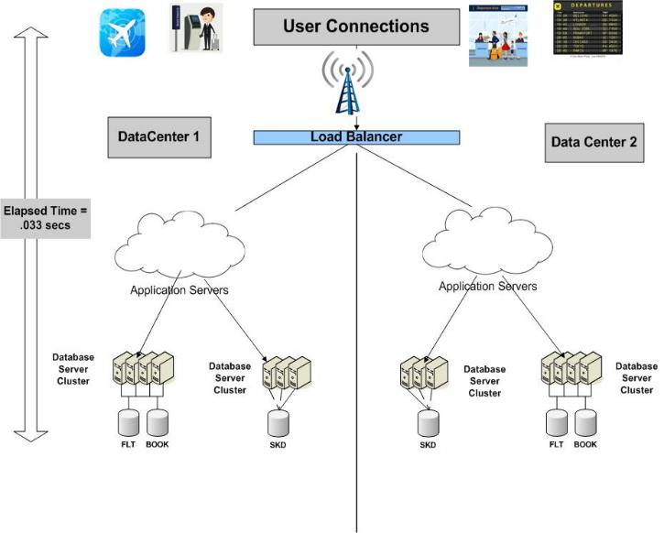
RDBMS in Delta Airlines: Use Case # 1

Slide 14
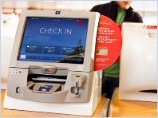

RDBMS in Delta Airlines: Use case # 2
Customer Checks in ATL – NYC
Seat selection: 23 C (Aisle)
Check in Bags: 2
FLT Info
Schedules
Customer Info
Cargo Info updated for this flight
Bookings
CARGO
Bags are flagged to be loaded into this flight.
Seat is purchased and marked as “Not Available” to others.
BAGS
SEATS

Slide 16
Database Management
Recoverability: Prepare for the Hardware, Software, Network and system failures. Take Backups of the databases so you can recover the operations quickly.
Availability: All the Mission Critical Applications are available 24x7 . Plan for Business Continuity and Disaster Recovery. Replicate the databases to another datacenter.
Security: All Databases (and other Infrastructure) have security implemented to protect the Data .
Maintainability: Patching / Upgrading to latest versions and /or any other fixes to improve performance.

Slide 17
Q & A

Slide 18
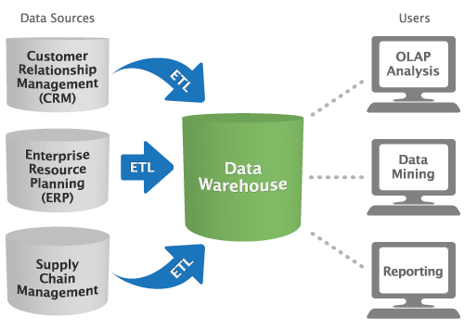
Data warehouse Use Case

Slide 19
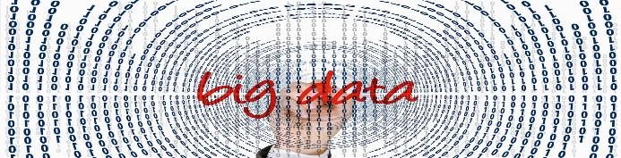
Large Volumes of Data :The Business Opportunity
100 Million daily Web transactions – eCommerce (Delta.com Website etc.)
1 million Daily Image Uploads -- Insurance Data (Auto/Home etc.)
10 Billion Daily Device Syncs – Consumer Data (Lifestyle/Social Media, Biometrics etc.)
10 million meters Hourly Uploads -- Utility (Power/Water etc.)
20 Million Daily monitoring – Healthcare (Pharma/Clinical etc.)

Slide 20
Use of Data
The Challenge
Recognizing a Pattern and Predicting Behavior
Finding Useful Data converting that into information
  Modeling, Statistics
  Econometrics
  Decision Science
  Psychology
Data Warehouse
Data Warehouse

Slide 21
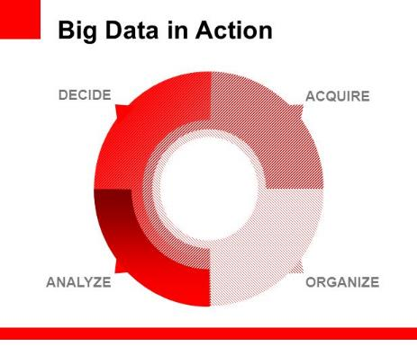
Data in Action:
Acquire
Organize
Analyze
Decide

Slide 22

Acquire:
Many sources:
* Social media/Web transactions ( delta.com) /Satellite Images etc

Slide 23

Organize
Store the data
Structured or Unstructured or semi structured.
Chose your Database servers Based on need: Operational Databases or Reporting/Analytics .
Reporting/Analytics - NoSQL databases (Not Only SQL)
Complex Event Processing - like Aggregations/Pattern Detection/Real Time Dashboards or Analytical Reporting etc
NOSQL –
Simple Data Model
Easily Scalable
Simple Administration

Slide 24


Analyze
Simple Querying and Reporting
Graph Analytics
Statistics
Data Mining
Spatial Analytics
Text Analytics
Decide
Print a boarding pass
Display Flight Information (Arrivals/Departures) on the Airport Screens .

Slide 25
Q & A

