Slide 1
Business Intelligence
Overview
MGS 4020
Dr. Satish Nargundkar

Slide 2
What is Business Intelligence?
Systems that provide information for Executive Decisions
Source: Data Warehouse
Analysis: Business Analytics
Monitoring: Business Performance Management (BPM)
User Interface: Dashboard

Slide 3
Data Warehouse
Transactional Data
Real time operations, normalized data
Warehoused data
Separate, updated as needed, used for analytics,
Often denormalized

Slide 4
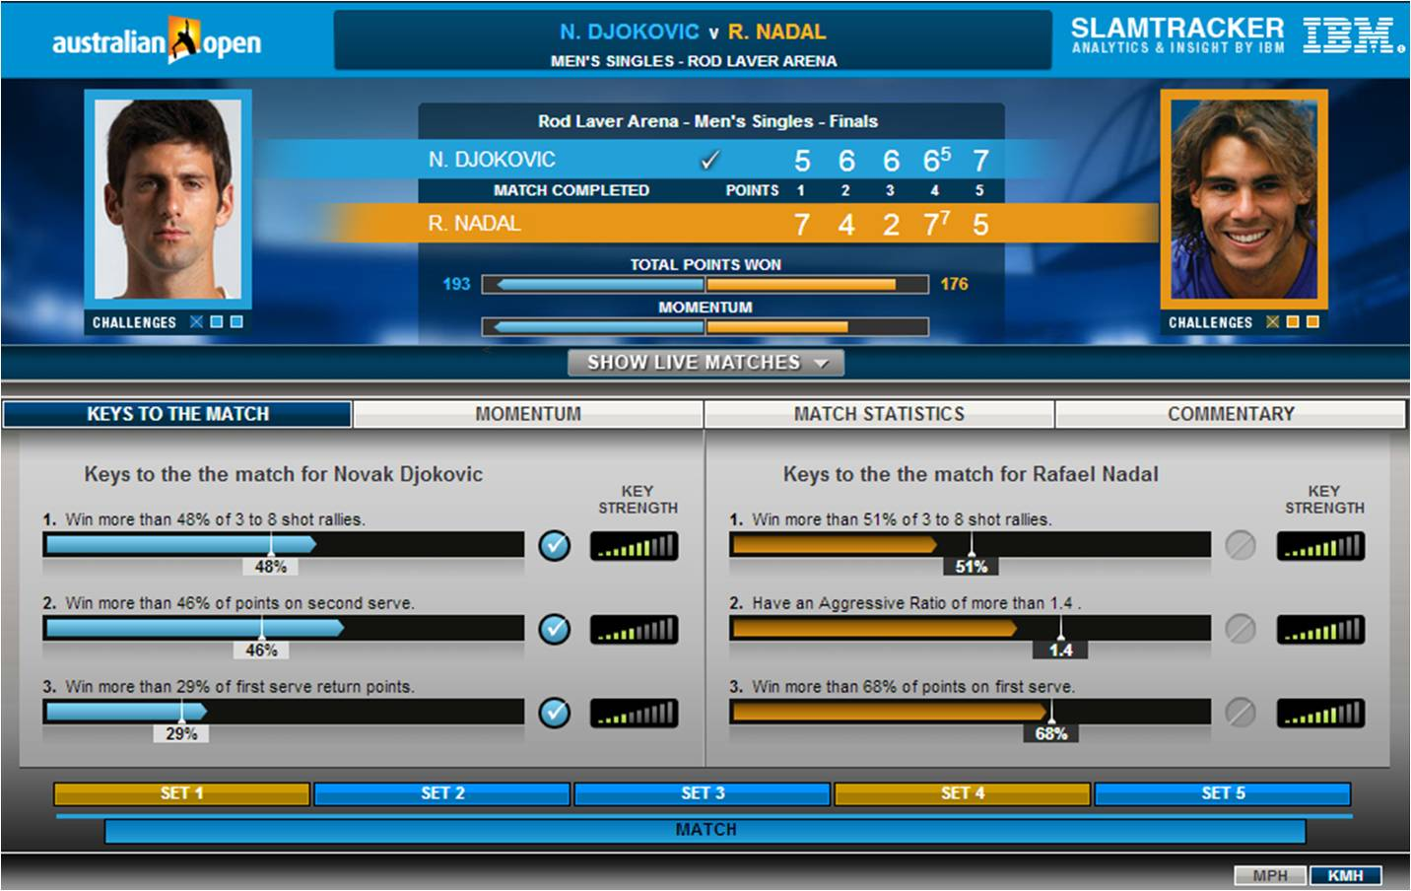
Analytics
Descriptive
What happened?
Reporting, Dashboards, Visualization
Predictive
What will happen?
Prediction, Classification, Segmentation,
Text Mining, Web Mining
Prescriptive
What do we do about it?
Simulation, Optimization,
Decision Modeling, Expert Systems

Slide 5
Business Performance Management
Identification of KPI (Key Performance Indicators)
For Georgia State – Retention Rates, Graduation Rates
Monitoring of KPIs
How to keep track?
Action towards the business goals
What if KPIs unsatisfactory?

Slide 6
Dashboards
User interface for monitoring KPIs

Slide 7
Dashboards

Slide 8
Analytics Ecosystem: Outer Layer
Technology Providers
Type of provider | What they do | Example Providers
Data Generation | Sensors | Fitbit, Videos, Health Apps
Data Mgt. Infrastructure | Storage, Access to data | SQL Server, SAP, Amazon Web
Data Warehouses | Integration of data Some Cloud-based | Oracle, Teradata Snowflake, Redshift
Middleware | Reporting, Descriptive Analytics | Cognos, SAS, Tableau
Data Service | External Datasets like demographics, weather | Nielsen, Acxiom, Equifax
Analytics Software | To describe, predict, prescribe | Tableau, SAS, R, Lindo, Gurobi

Slide 9
Analytics Ecosystem: Inner Layer
Technology Accelerators
Type of provider | What they do | Example Providers
App Developers | Pre-packaged analytics solutions | Acxiom, FICO, IBM (Sports) Soundhound, Shazam, Alexa
Analysts/Influencers | Professional Organizations, Consultants | INFORMS, Book Authors like Davenport
Academic Institutions | Education, Certification | Georgia State, Georgia Tech, KSU, INFORMS (CAP)
Regulators | Network and communication rules | FCC, FTC, NIST

Slide 10
Analytics Ecosystem: The core
Analytics End User Organizations
Every organization!

