Slide 1
Lean Tools & Approaches
MGS 4020
Satish Nargundkar

Slide 2
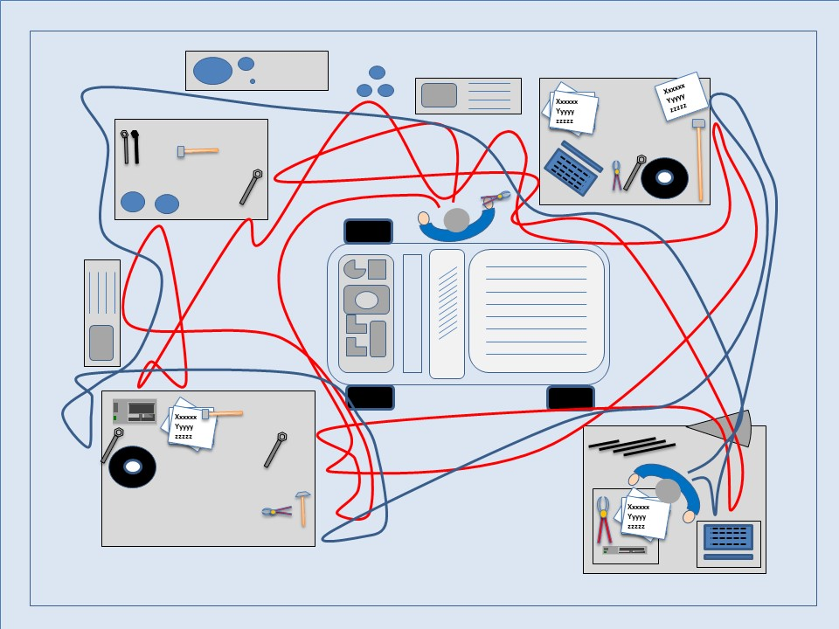
Waste (“Muda”) Elimination
Types of Waste – TIM WOOD
T ransportation
I nventory
M ovement
W aiting
O verproduction
O ver-processing
D efects
Spaghetti Diagram
(Source: http://leanprogression.co.uk/lean-techniques/spaghetti-diagram)
Youtube Video

Slide 3
Smooth Flow: Takt Time, Cycle Time, Throughput Time
Takt Time.
German “Takt” means Beat, as in the timing of music. It sets the rate at which the process should operate based on customer demand.
Takt Time = Time Available/Customer Demand
Cycle Time
Time interval between finished goods (between one piece exiting the system and the next)
Cycle time also can refer to the time taken to complete each step in the process.
Throughput Time: Time for one part to move through system.
Six Sigma Academy Amsterdam Video

Slide 4
Value Stream Mapping (VSM)
Goal: To understand what is actually happening in the process. To help see problems clearly.
Drawing the VSM
Show process steps
Note time taken for each step (Value Added Time)
Note time between steps (Non Value Added Time)
Sum both for the entire process
Compute efficiency
GEMBA: Walk the process! Take samples, note variations too.
Ron Pereira, GEMBA Academy Blog

Slide 5
VSM Templates Online
https://goleansixsigma.com/value-stream-mapping/
https://www.lucidchart.com/pages/templates/value-stream-map
There are many other online resources for VSMs.

Slide 6
VSM Exercise
Draw a value stream map
Process: Laundry (one washer, one dryer)
Four people waiting to start washing.
Loading takes 3 minutes
Washer takes 40 minutes.
Transfer to dryer takes 3 minutes
6 loads waiting to dry
Dryer takes 80 minutes
Folding/hanging takes 10 minutes
What is the Cycle Time? Throughput Time?

Slide 7
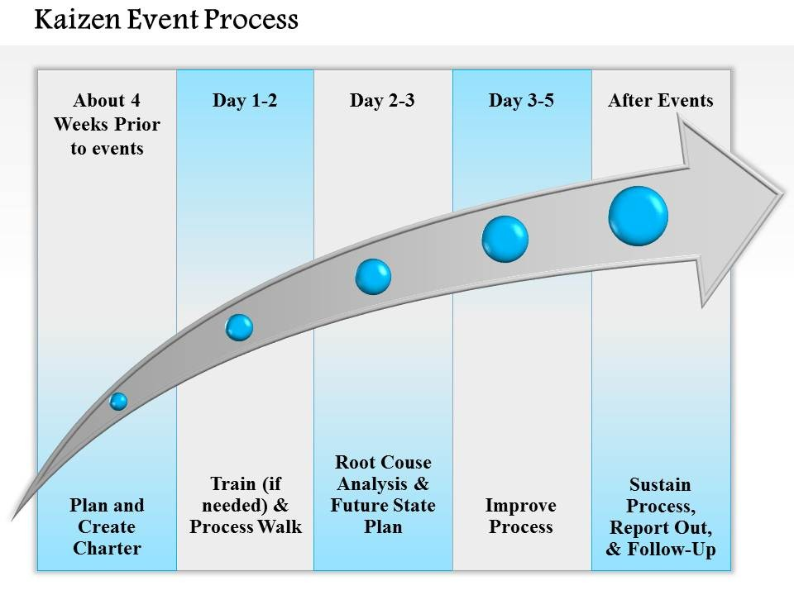
Kaizen
One week process to implement Lean
Source: http://jipsportsbj.info/kaizen-presentation-format/kaizen-presentation-format-0714-kaizen-event-process-powerpoint-presentation-slide-template-download/

