Slide 1
Business Intelligence
MGS 4020
Satish Nargundkar

Slide 2
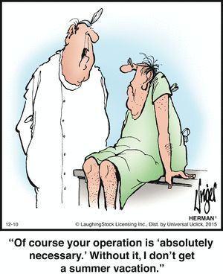
Introduction to Lean
Toyota Motor Corp.
Elimination of waste
Smooth flow
Quick Implementation
5S Philosophy
Seiri - Sort/Separate – Get rid of the unnecessary
Seiton - Straighten – Put things where most needed
Seiso - Sweep/Shine – Clean, paint
Seiketsu – Standardize – Create agreed upon procedures
Shitsuke – Sustain – Discipline – Make it a habit
Practice being this, not just doing it once.
https://www.pinterest.com/pin/423971752400603921/

Slide 3
Introduction to Six Sigma
Started by Motorola, GE
Improve Quality
Data/Analysis focus
Reduction of variation
Six standard deviations (Sigmas) on either side of mean must fit within the customer specs.
Can take a few months to implement

Slide 4
Standard Deviation (Sigma) Exercise 1
 | Variable |  | Deviation | Squared
Obs | Value |  | from Mean | Deviation
1 | 5
2 | 6
3 | 7
4 | 8 |  |  |  |  |  | Sum of Squared
5 | 9 |  |  |  |  |  | Deviations (SSD)
Sum =
Mean = |  |  |  |  |  |  | Mean Squared
 |  |  |  |  |  |  | Deviation (MSD = SSD/n-1))
 |  | Standard Deviation = Square Root of MSD =

Slide 5
Standard Deviation (Sigma) Exercise 2
 | Variable |  | Deviation | Squared
Obs | Value |  | from Mean | Deviation
1 | 5
2 | 8
3 | 11
4 | 14 |  |  |  |  |  | Sum of Squared
5 | 17 |  |  |  |  |  | Deviations (SSD)
Sum =
Mean = |  |  |  |  |  |  | Mean Squared
 |  |  |  |  |  |  | Deviation (MSD = SSD/n-1)
 |  | Standard Deviation = Square Root of MSD =

Slide 6
Interpretation
What do the two sigma values we computed tell us about the respective datasets?

Slide 7
Excel Exercise in Computing Sigma
See dataset provided.

Slide 8
Interpretation
How many data points fall within
+/- One Sigma from the Mean?
How many fall within
+/- 2 sigma?
+/- 3 sigma?
….
+/- 6 sigma?

Slide 9
What is 6 sigma Quality?
Roughly 3.4 defects per million opportunities.

