Slide 1
Six Sigma DMAIC Process
MGS 4020
Satish Nargundkar

Slide 2
Key Roles
The Boss
Champion
Senior Manager,
Signs off on project
Master Black Belt
Consulting role across many projects
Black Belt
Project Lead
Green Belt
Has basic knowledge of the DMAIC process.

Slide 3
Before Starting the Project
The Voice!
VOC
VOE
VOP
Analysis
Standard Reports
Segmentation (drill down)
Time Series, Cross-section

Slide 4
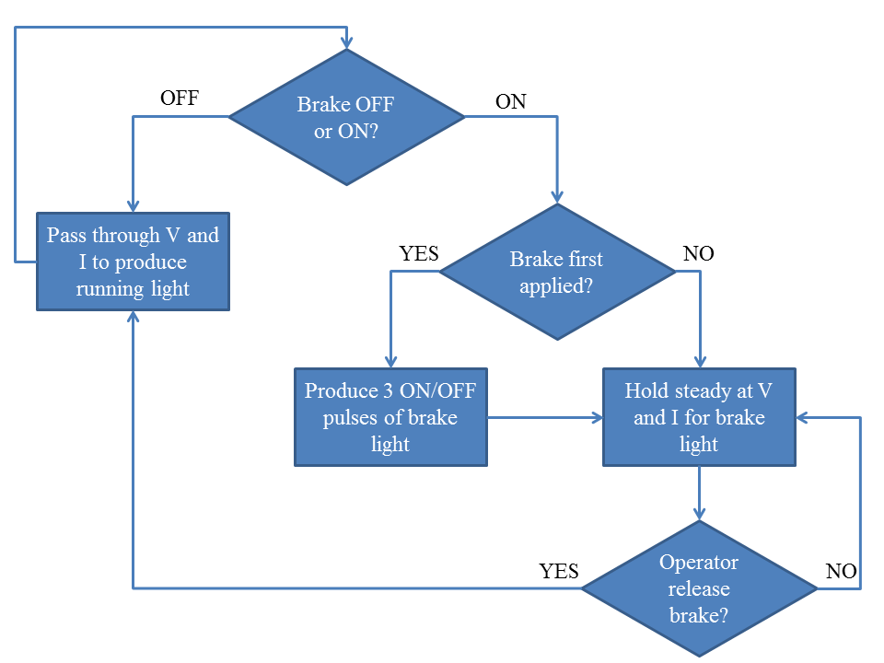
The Define Phase
SMART Objective (y)
Specific, Measurable, Achievable,
Relevant, Time-based
Process Flowchart
Map the current process
Estimated Benefits
If target achieved, what are the benefits?
Project Charter
Problem Statement, SMART Objective,
Team Members & Roles, Estimated Benefits.

Slide 5
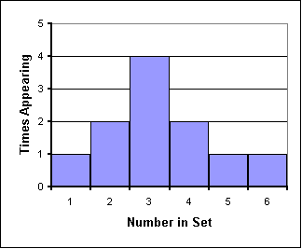
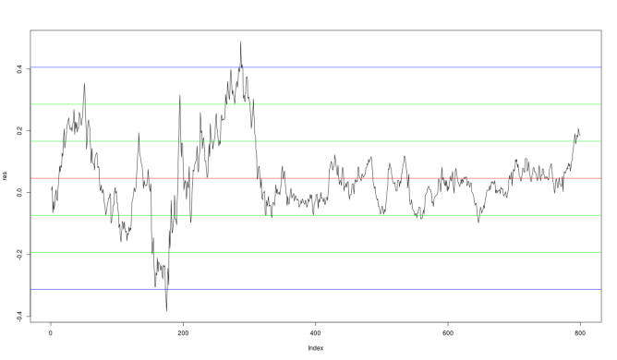
Define: Basic Analysis
Descriptive analysis of y
Mean, Standard Deviation
Histogram, Time Series Chart
Break down by segments

Slide 6
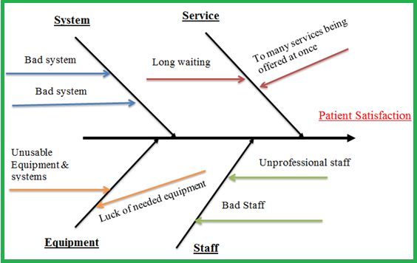
The Measure Phase
Potential Causes of y (the Xs)
Fishbone (Ishikawa) Diagram
Collect data on the Xs
Descriptive analysis of Xs

Slide 7
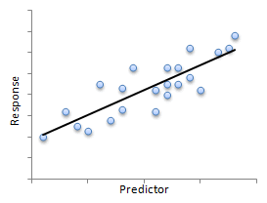
The Analyze Phase
Relate each X to Y
Scatterplots, Correlations
Find most important Xs
(analyze all Xs simultaneously)
Regression
Delphi method

Slide 8
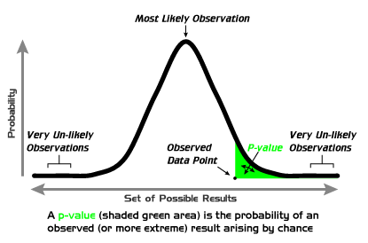
The Improve Phase
Implement changes
Measure improvement
Hypothesis tests to prove significant change
Tests for Means, Proportions
Tests for Variances

Slide 9
The Control Phase
Sustaining the improvement
New SOPs
Error Proofing
Checklists
Control Charts
Other Monitoring

Slide 10
Celebrate!

