Slide 1
Cross Industry Standard Process for
Data Mining (CRISP-DM)

Slide 2
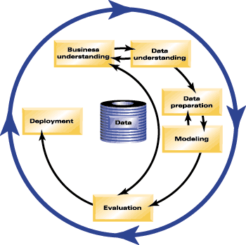
Data Mining Process
Source: CRISP-DM (SPSS.com website)

