Slide 1
Operations
PERS 2002
Satish Nargundkar

Slide 2
Overview: Demand Characteristics
What is Ops?
Managing resources efficiently/effectively to create products/services to meet demand.
Demand Characteristics
Volume – repeatability – affects standardization
Variety – range of products – affects inputs, setup cost
Variation – predictability – affects inventory, lead time
Visibility – customer contact – needs interpersonal skills

Slide 3
Operations Goals
Quality – Meet specs, Low variation
Speed – Lead times for order taking, delivery
Dependability – Keep promises, keep them informed
Flexibility – Customization, ability to change midstream
Cost - minimization

Slide 4
Operations Decision Areas
Capacity Planning
Match capacity to demand
Supply Networks
Vertical integration – how much to own? How many suppliers? Types of Relationships
Process Technology
Converting resources to product/service efficiently
Organization/Process Improvement
Reporting structure, LSS, Change Management

Slide 5
Operations Strategy Matrix
Objective | Capacity | Supply Network | Process Technology | Organization /Development
Quality
Speed
Dependability
Flexibility
Cost
Assignment: How does your organization manage the four decision areas to achieve its operational objectives?

Slide 6
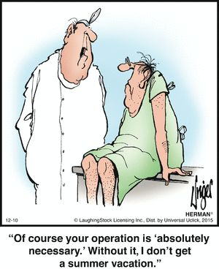
Introduction to Lean
Toyota Motor Corp.
Elimination of waste
Smooth flow
Quick Implementation
5S Philosophy
Seiri - Sort/Separate – Get rid of the unnecessary
Seiton - Straighten – Put things where most needed
Seiso - Sweep/Shine – Clean, paint
Seiketsu – Standardize – Create agreed upon procedures
Shitsuke – Sustain – Discipline – Make it a habit
Practice being this, not just doing it once.
https://www.pinterest.com/pin/423971752400603921/

Slide 7
Introduction to Six Sigma
Started by Motorola, GE
Improve Quality
Data/Analysis focus
Reduction of variation
Six standard deviations (Sigmas) on either side of mean must fit within the customer specs.
Can take a few months to implement

